Slide 1
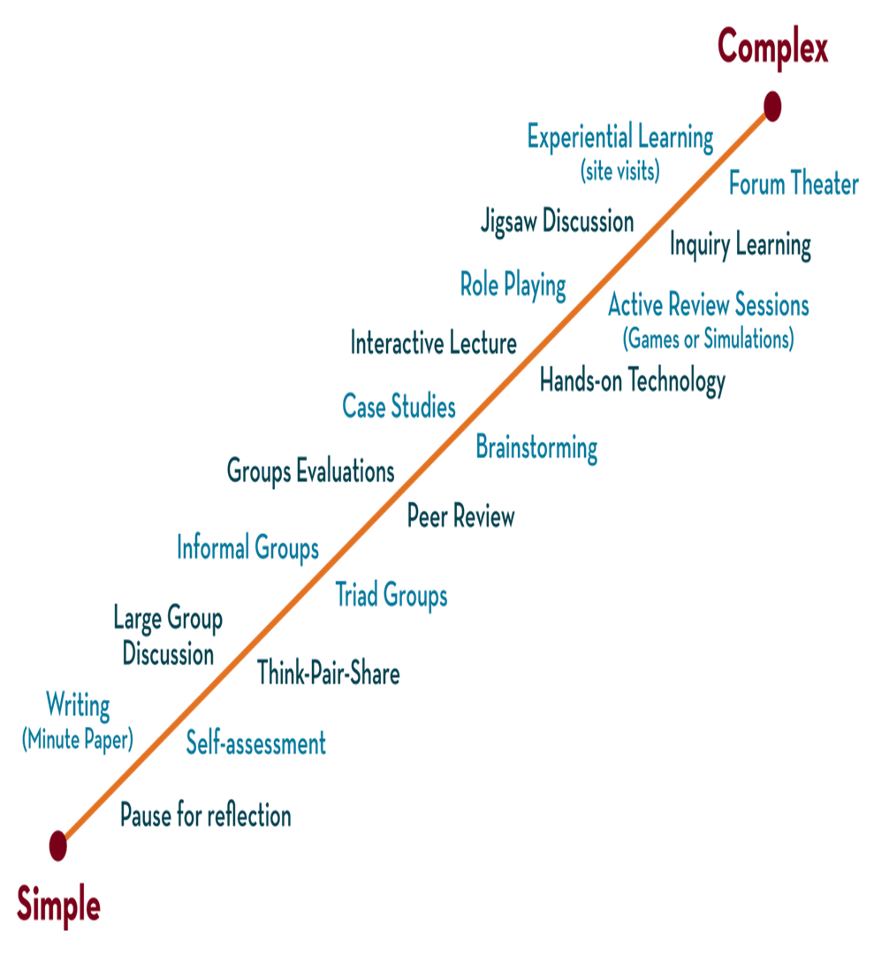

Department of CSE
DESIGN AND ANALYSIS OF ALGORITHMS
24CS2203
Topic:
PERFORMANCE ANALYSIS
Session - 2

Slide 2





AIM OF THE SESSION
To familiarize students with the concept of the Performance Analysis.
INSTRUCTIONAL OBJECTIVES
This Session is designed to:
Demonstrate :- Recursive Algorithms, Performance Analysis.
Describe :- Time Complexity and Space Complexity.
LEARNING OUTCOMES
At the end of this session, you should be able to:
Define :- Recursive Algorithms, Performance Analysis
Describe :- Recursive algorithms, Time Complexity and Space Complexity
Summarize:- Towers of Hanoi and Examples of Time complexity and space complexity

Slide 3
Performance Analysis
The efficiency of an algorithm can be decided by measuring the performance of an algorithm. We can measure the performance of an algorithm by computing the amount of “time and space” requirement.
We have to implement performance analysis. We mainly concentrate on
  Space complexity
  Time complexity
Ex: Algorithm Add(a,b,c)
{
//a, b, c are floating type
return a+b+c;
}
a, b, c allocate one-word size then the total size is 3.
Space Complexity S(p) = 3
Case for arrays it will be S(p)=n

Slide 4
Space Complexity
Space complexity can be defined as the algorithm’s required space or memory.
To compute the space complexity we have to use 2 factors i.e.
  Constant
  Instance characteristics
=> The space requirements S(p) can be given as S(p) = C+ Sp
Where C = constant i.e. fixed part and denotes the space of inputs and outputs. This space is an amount of space taken by instructions, variables, and identifiers.
Where Sp = Space dependent upon instance characteristics

Slide 5
Space complexity Ex
Ex: Algorithm Add(x, n)
{
//sum and x[i]
sum := 0.0;
for i = 1 to n do
sum := sum+x[i];
return sum;
}
Amount of space required: n space for x[] , 1 space for n, 1 space for i and 1 space for sum.
Therefore, S(p) = n+3

Slide 6
Time complexity
The time complexity can be defined as the amount of time required to execute an algorithm.
Time complexity is based on compile time and run time.
Time complexity is generally computed based on run time or execution time.
Methods to compute time complexity
  Step count method
  Tabular method

Slide 7
Step count method
Algorithm Message(n) ---------- 0
{ ----------------------------------- 0
for i = 1 to n do ------------ n+1
write (“Hello”); --------- n
}
Step count = 2n + 1
The time complexity is O(2n+1) = O(n)

Slide 8
Time complexity Ex
Algorithm Add(x, n) ---------- 0
{ ----------------------------------- 0
//sum and x[i]
sum := 0.0; ----------------- 1
for i = 1 to n do ------------ n+1
sum := sum+x[i]; ----- n
return sum; ----------------- 1
}
Step count = 2n + 3
The time complexity is O(2n+3) =O(n)

Slide 9
Time complexity Ex
Algorithm Add(a, b, c, m, n) ---------- 0
{ ----------------------------------- 0
for i = 1 to m do ------------ m+1
for j = 1 to n do ------------ n+1
c[i, j] = a[i, j] + b[i , j]; ------- mn
}
Step count = 2mn + 2m + 1
The time complexity is O(2mn + 2m + 1) = O(mn)

Slide 10
Time complexity Ex
Algorithm RSum(a,n) // Recursive sum of n numbers let count be global var = 0
{
count:=count+1; // for the if conditional
if(n ≤ 0) then
{
return 0;
count:=count+1; // for the return
}
else
{
return RSum(a,n-1)+a[n];
count:=count+1; // For the addition, function invocation and return
}
}

Slide 11
When analyzing a recursive program for its step count, we often obtain a recursive formula for the step count.
We obtain the following recursive formula for the above (RSum) algorithm.
t_{RSum}(n) =
2
If n=0
2+ t_{RSum}(n-1)
If n>0

Slide 12
One way of solving such a recursive formula is by using the substitution method.
t_{RSum} (n) = 2+t_{RSum}(n-1)
= 2+2+t_{RSum}(n-2)
= 2(2)+t_{RSum}(n-2)
= 2+2+2+_{tRSum}(n-3)
= 3(2)+t_{RSum}(n-3)
:
:
= n(2) +t_{RSum}(n-n)
= 2n+t_{RSum}(0)
= 2n+2
The step count for Rsum is 2n+2

Slide 13
Tabular method
    Determine the total number of steps contributed by each statement per execution × frequency
    Add up the contribution of all statements

Slide 14
Tabular method Ex
Iterative sum of n numbers
Statement | s/e | frequency | Total steps
Algorithm sum(a, n) { s:=0 ; for i:=1 to n do s:=s+a[i]; return s; } | 0 0 1 1 1 1 0 | -- -- 1 n+1 n 1 -- | 0 0 1 n+1 n 1 0
Total |  |  | 2n+3

Slide 15
Tabular method Ex
Recursive sum of n numbers
Statement | s/e | Frequency n=0 n>0 | Total steps n=0 n>0
Algorithm RSum(a,n) { if( n ≤ 0 ) then return 0; else return Rsum(a,n-1)+a[n] ; } | 0 0 1 1 1+x 0 | -- -- -- -- 1 1 1 0 0 1 -- -- | 0 0 0 0 1 1 1 0 0 1+x 0 0
Total |  |  | 2 2+x

Slide 16
for i in range(n):
swapped = False
for j in range(0, n-i-1):
if arr[j] > arr[j+1]:
arr[j], arr[j+1] = arr[j+1], arr[j]
swapped = True
if (swapped == False):
break

Slide 17
SUMMARY
Performance analysis helps us to select the best algorithm from multiple algorithms to solve a problem.
When there are multiple alternative algorithms to solve a problem, we analyze them and pick the one which is best suitable for our requirements.
Time complexity of an algorithm quantifies the amount of time taken by an algorithm to run as a function of the length of the input.
Space complexity of an algorithm quantifies the amount of space or memory taken by an algorithm to run as a function of the length of the input.

Slide 18


SELF-ASSESSMENT QUESTIONS
For moving 10 disks in towers of Hanoi problem, total moves required are
A. 1023
B. 512
C. 1024
D. 511
For the recurrence relation T(n)=T(n−1)+1, what is the time complexity?
A. O(1)
B. O(n)
C. O(n log n)
D. O(n^2)

Slide 19
TERMINAL QUESTIONS
1. Solve Towers of Hanoi problem using 5 disk
2. Explain the process of creating a table using the tabular method to
analyze an algorithm.

Slide 20
REFERENCES FOR FURTHER LEARNING OF THE SESSION
Text Books :
1. Ellis Horowitz, Sartaj Sahni and Sanguthevar Rajasekaran, “Fundamentals of ComputerAlgorithms”, 2nd Edition, University Press, 2008.
2. Cormen, Leizerson &Rivest, “Introduction toalgorithms”, 3rd Edition, Prentice-Hall, 2002.
3. Jon Kleinberg and Eva Tardos, “Algorithm Design”,Pearson Education, 2006.
Reference Books :
1. Robert Sedgewick and Kevin wayne , “Algorithms”, 4th edition, Addison WesleyProf.,(2011).
2. Anny Levitin, “Introduction to Design and Analysis of Algorithms”, 2rd Edition, PersonEducation Press. (2007).
3. Michael T.Goodrich and Roberto Tamassia, Algorithm Design: Foundations,Analysis and Internet Examples, Second Edition, Wiley-India, (2006).
4. Steven S. Skiena, “The AlgorithmDesign Manual”, Second Edition, Springer, (2008)
MOOCS :
1. https://www.coursera.org/specializations/algorithms?= 2.https://www.coursera.org/learn/dynamic-programming-greedy-algorithms#modules

Slide 21
THANK YOU

